Slide 1

Distributed reconstruction of information cascades
Michael Huber
Study Course:
Applied Computer Science
Master Thesis
Albert-Ludwigs-Universität
Faculty of Engineering
Chair of Web Science
11. December 2014

Slide 2
Outline
Introduction
Overall Distributed Approach
Methods
Graphpartitioning
Allocation
Distributed Reconstruction
Results
Conclusion
Future Work

Slide 3
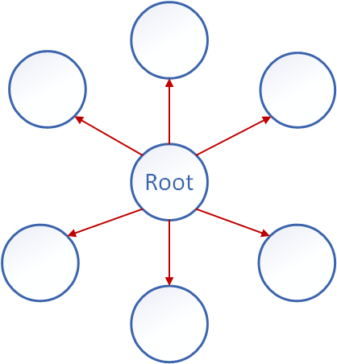
Introduction
What is an information cascade?
An information cascade represents the spread of an information through the interaction of users.
The information cascade shows the interaction in timely correct succession.
What kind of information cascades do we use?
Retweet cascades from Twitter.
A retweet only knows about the root tweet and itself.
Star cascade

Slide 4
Introduction
Why do we want to reconstruct them?
Knowledge about information spread can be used for multiple purposes.
It can be used to reach more people.
It can be used to reach people faster.
Examples:
Place advertisement on specific twitterusers.
Make specific twitterusers post a message to spread fast.

Slide 5
Introduction
How to reconstruct them?
The reconstruction was already implemented for a single machine.
To reconstruct a retweet cascade two things are needed:
A social graph representing the user connections.
The retweets of a cascade.
Through the user ids in the reweets and the connections among users in the social graph, a retweet cascade can be reconstructed.

Slide 6
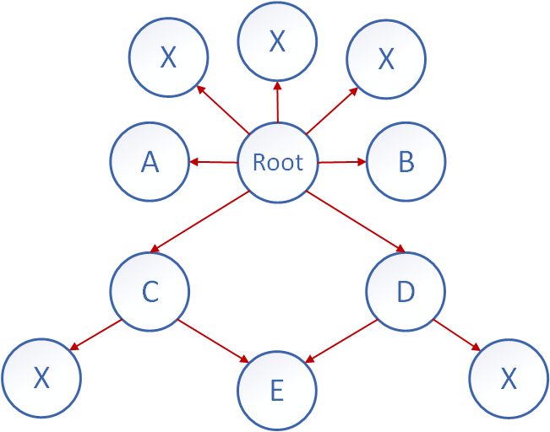
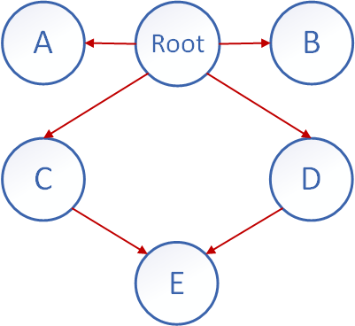
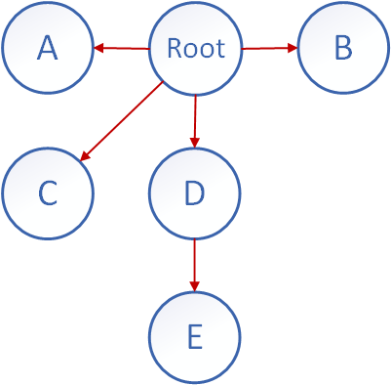
Introduction
Example of a reconstruction:
Tweets in cascade: Root tweet and retweets A, B, C, D, E.
The X in the social graph denotes users that did not take part in the cascade.
Social Graph
Reconstructed
Original

Slide 7
Introduction
Why do we need a distributed reconstruction?
The reconstruction needs to hold the social graph in main memory to maintain a good computation speed.
Social graphs can grow quite large. Obama has around 50 million followers on twitter which amounts to about 760 gigabytes of graph data.
To hold large social graphs in the main memory we need to split the graph and distribute it to multiple nodes.
Also there might be a possible speedup of the reconstruction when reconstructing multiple cascades in parallel.
For a live reconstruction of retweets the social graph should be constantly available in the main memory.

Slide 8
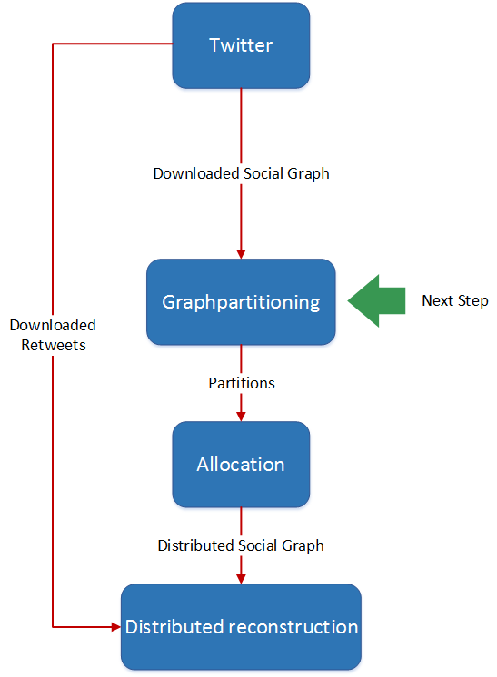
Overview Distributed Approach

Slide 9
Graphpartitioning
What kind of partitioning do we need?
Information is likely spread inside of communities.
We need a different a approach to normal graphpartitioning as we need a graphpartitioning that is based on communities.
Communities shall not be split by partitioning as the reconstruction later on should mostly be local.
We do not necessarily need balanced partitions as we also allocate later on.

Slide 10
Graphpartitioning
The basis for the partitioning is an activity graph which is constructed out of retweet cascades.
GraphChi is used to partition the graph.
The algorithm that is used to partition the graph
was already existing and modified for needs of the thesis.
is based on label propagation.
finds the most popular neighbor for every vertex in a graph.

Slide 11
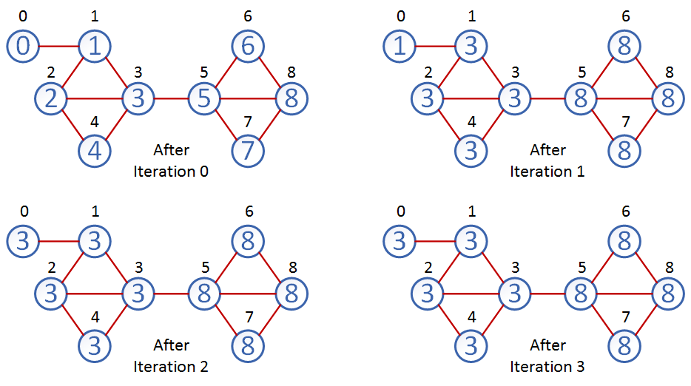
Graphpartitioning Example without weights

Slide 12
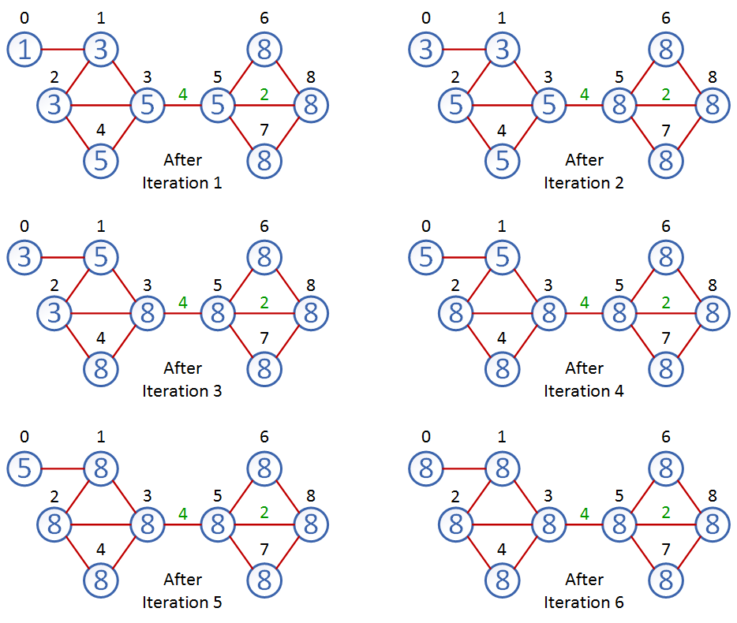
Graphpartitioning Example with weights

Slide 13
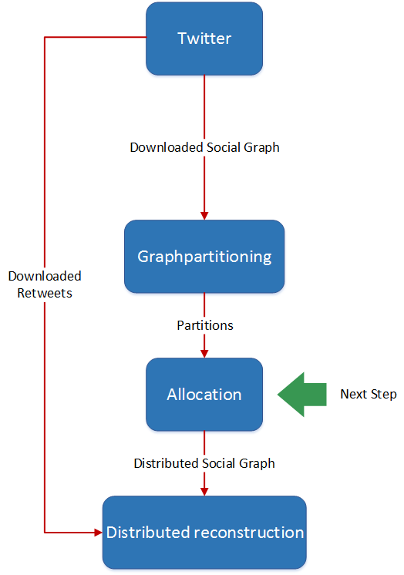
Overview Distributed Approach

Slide 14
Allocation
Why do we need an allocation?
Up until now we only have a lot of graphpartitions in different sizes.
The graphpartitions need to be distributed onto nodes in a computer cluster so that the reconstruction can access the social graph later on.
What prerequisites do we have?
The number of computer nodes in the cluster.
The amount of memory the computer nodes have available.
The number of bytes a follower has.
What edges do the graphpartions have among themselves.

Slide 15
Allocation
The goal is to minimize the edges between the computer nodes
A greedy approach is sufficient for the allocation as we do not need a perfect solution.
At first a random distribution of the graphpartitions onto the nodes is done.
Then multiple steps of hill climbing are executed to improve the random solution.

Slide 16
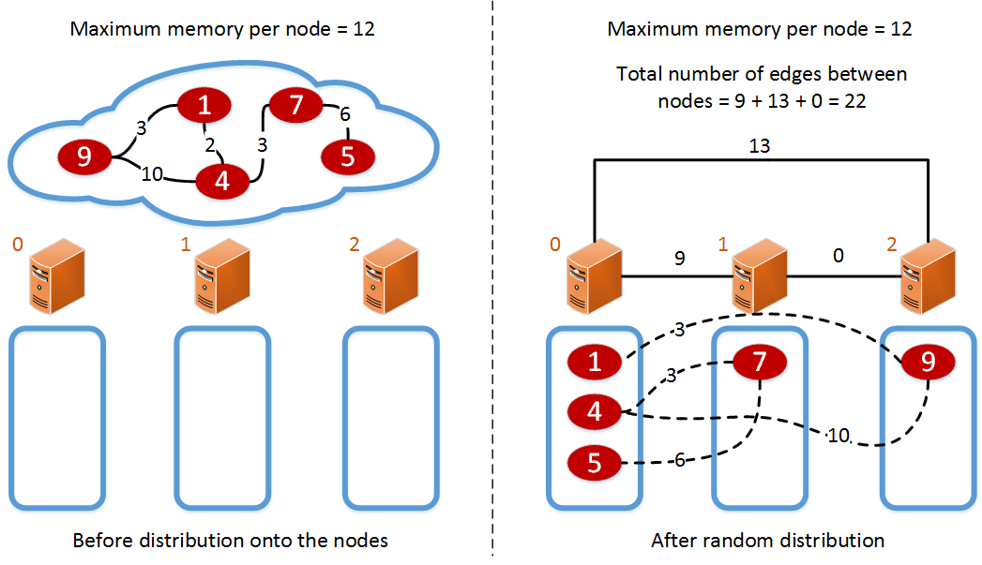
Allocation Example

Slide 17
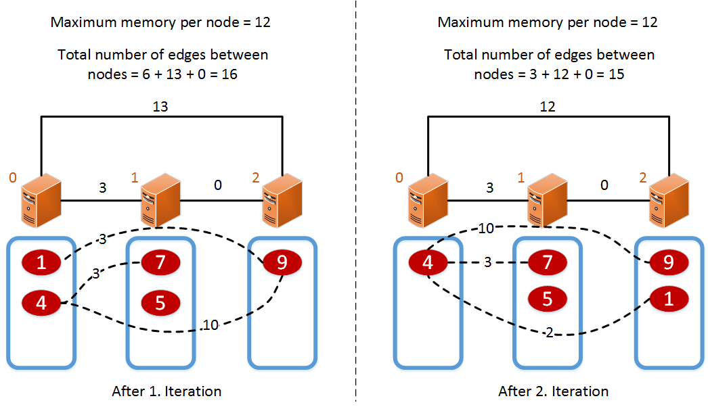
Allocation Example

Slide 18
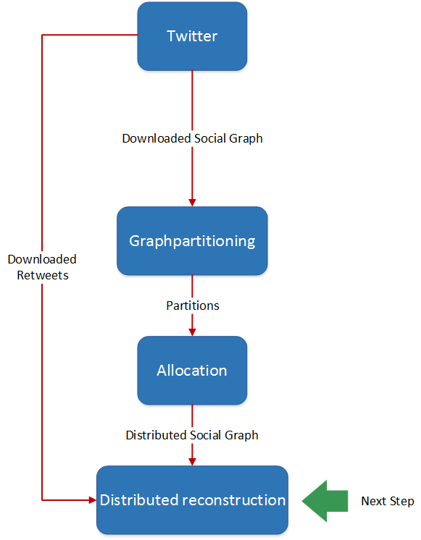
Overview Distributed Approach

Slide 19
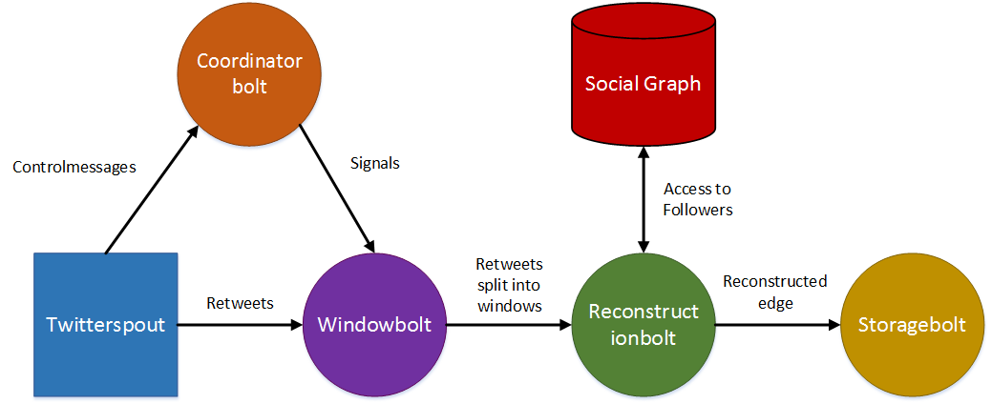
Distributed Reconstruction
The reconstruction is based on Apache Storm.
Topology for the central recontruction:

Slide 20
Distributed Reconstruction
Questions that arise when the central approach shall be transformed into a distributed approach.
How should the spouts and bolts be distributed among the computer nodes?
How do the retweet cascades reach the computer nodes with the most social graph files, which are relevant to them?
What happens when a user which the reconstruction needs is not located on the computer node?

Slide 21
Distributed Reconstruction
How should the spouts and bolts be distributed among the computer nodes?
They should be distributed in a way that only a minimum of messages must be sent around.
A reconstructionbolt must be available on each node that is doing a reconstruction.
To limit the number of messages in the network each reconstructing node also gets a storagebolt.
The twitterspout, coordinatorbolt and windowbolt are also put onto the same node.

Slide 22
Distributed Reconstruction
How do the retweet cascades reach the computer nodes with the most social graph files, which are relevant to them?
A routingbolt needs to be introduced which knows where to send the retweets to.
The routingbolt holds a map of the location of users onto nodes in the computer network.
The retweets of a cascade get routed to the computer node where the root user of the retweet cascade is located.

Slide 23
Distributed Reconstruction
What happens when a user which the reconstruction needs is not located on the computer node?
Messages need to be sent around the network to find out where the user is located.
The routingbolt sends a request message to the reconstructionbolt which holds the user.
That bolt sends the information in a response message to the reconstrutionbolt which is reconstructing the cascade.

Slide 24
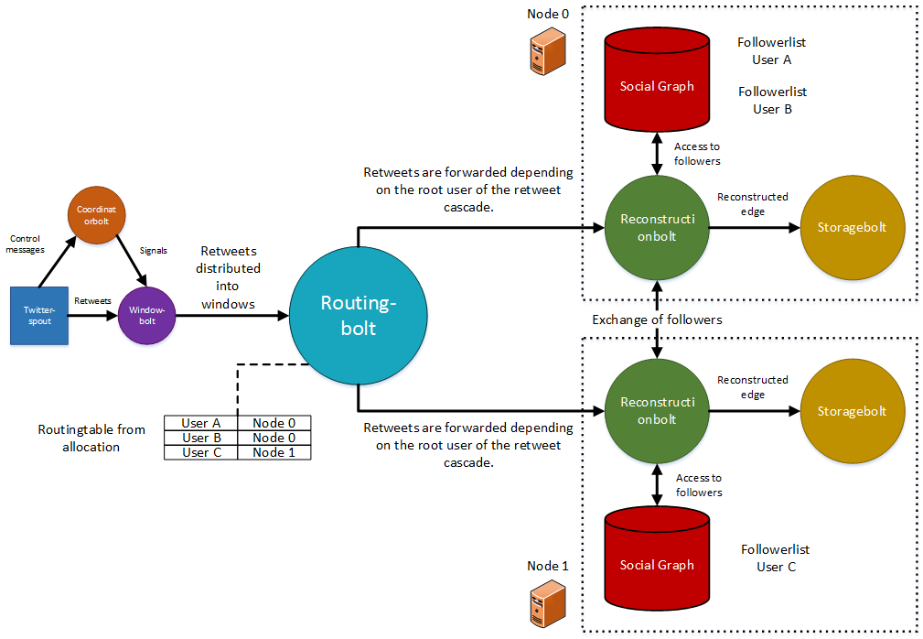
Distributed Reconstruction Distributed Model

Slide 25
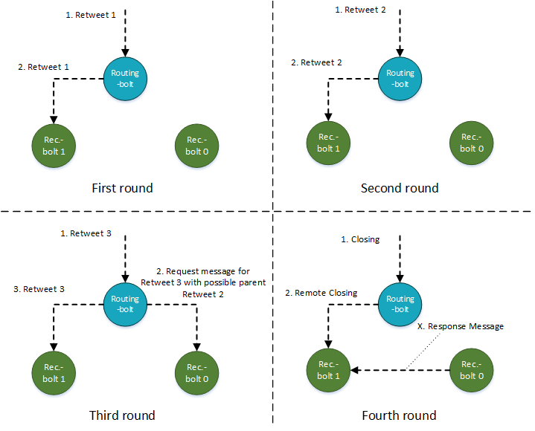
Distributed Reconstruction Message model

Slide 26
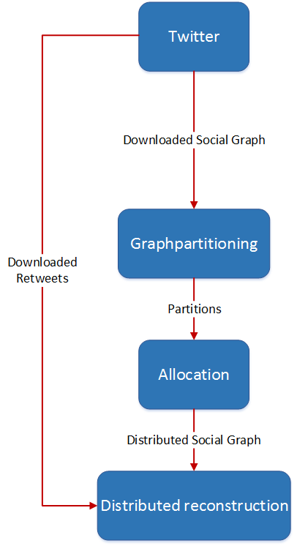
Overview Distributed Approach
The distributed reconstruction
is finished.
Results are coming up next.

Slide 27
Results
Dataset:
Cascades from Olympics 2012 London.
Single cascades in different sizes:
Smaller: 3.500 retweets
Small: 7.226 retweets
Middle: 14.847 retweets
Large: 29.783 retweets
Larger: 60.451 retweets
Multiple cascades with different sizes:
Mixed: 240.543 retweets within 611 cascades
What are we interested in?
Runtime
Remote calls
Memory usage

Slide 28
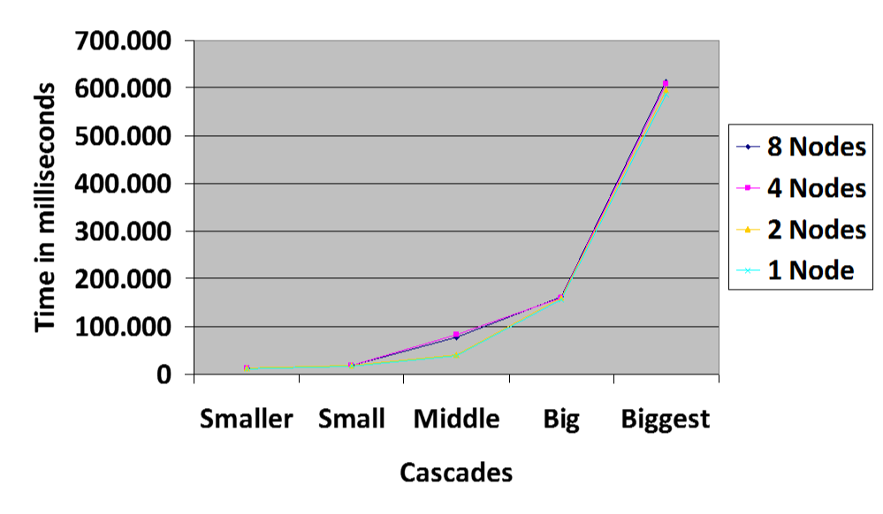
Results Single Cascades Runtime

Slide 29
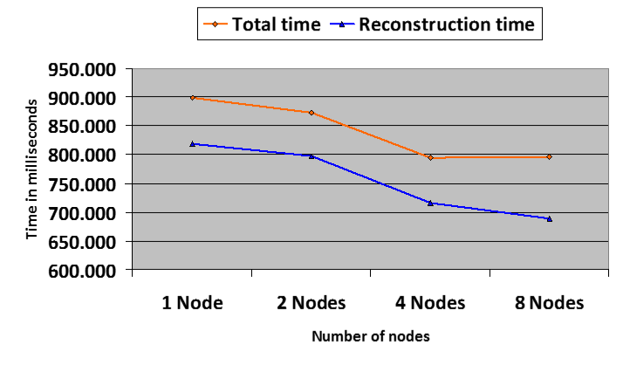
Results Multiple Cascades Runtime

Slide 30
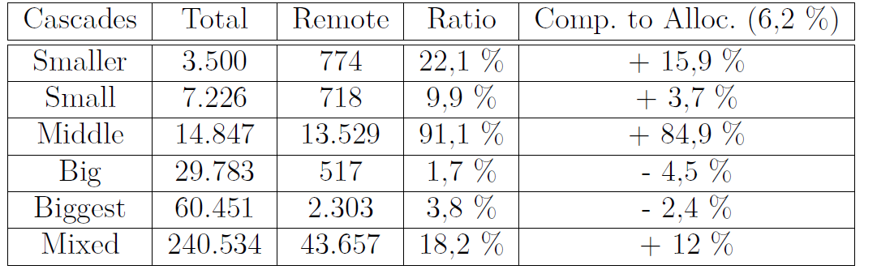
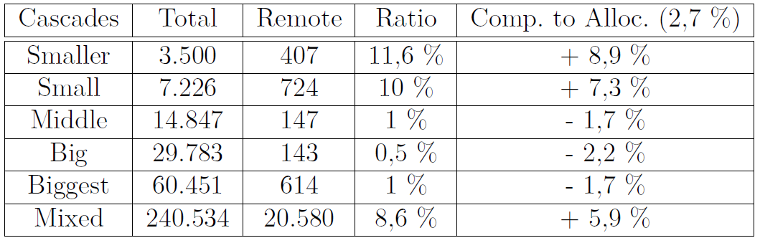
Results Remote Calls
Remote calls for 8 nodes:
Remote calls for 2 nodes:

Slide 31
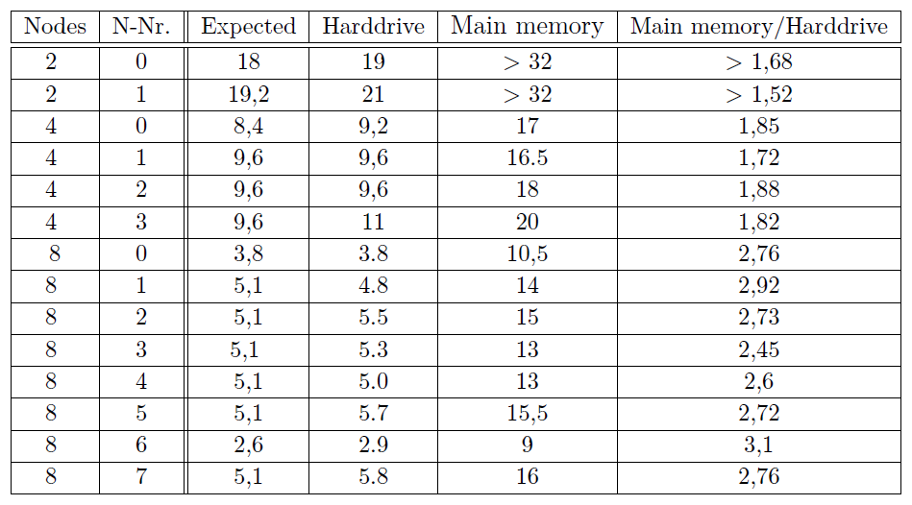
Results Memory Usage
Memory usage of social graph in gigabytes

Slide 32
Conclusion
A system for doing a distributed reconstruction of information cascades was successfully created and evaluated.
The social graph can be distributed to multiple nodes and thus a large graph can be hold in main memory.
The speed of the computation is comparable to the centralized version of the reconstruction when it comes to single cascades.
A speedup of the reconstruction could be observed for multiple cascades due to smaller probing times for the hashtable of the social graph.
A speedup of doing the reconstruction in parallel could not be observed but is likely to be seen for even larger and more cascades.

Slide 33
Conclusion
Complex cascades seem to be unsuited for a distributed reconstruction due to a high number of remote calls but this should be proven in more experiments.
The main memory usage of the social graph was overall larger than expected.

Slide 34
Future Work
More experiments:
More and larger cascades to test for possible speedup.
Complex cascades to test for number of remote calls.
Improvements of system:
Improve distributed message system to bulk messages even more.
Send distributed messages piggyback with normal retweets.

Slide 35
Questions
Thank you for your attention!
More questions?
?

